Slide 1
L3. Instance Recognition
Oleksandr Baiev, PhD
Head of Machine Perception Lab
Samsung R&D Institute Ukraine

Slide 2
Course overview
L1. Introduction to Computer Vision
L2. Basics of Deep Learning for Computer Vision
P1. Tensorflow basics
L3. Instance Recognition
P2. Train Simple Model
P3. Model Improvement. Pre-trained models

Slide 3
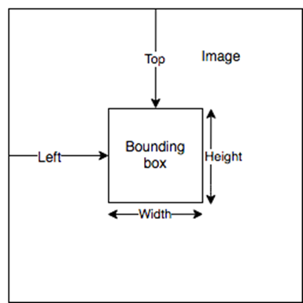
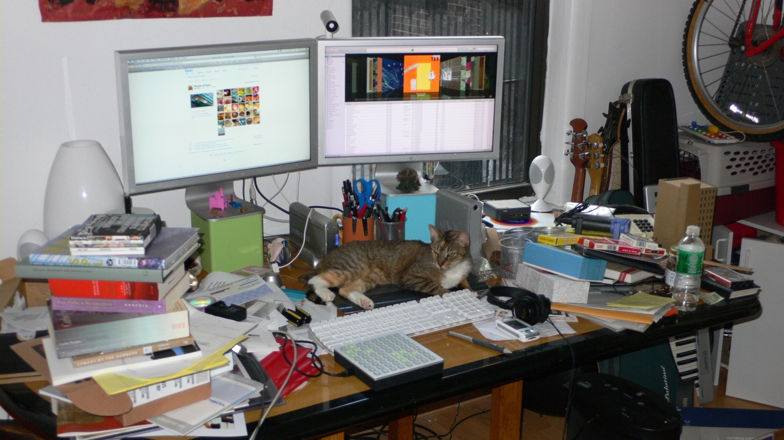
Object Detection. Bounding Box
annotation {
"image_id“ : int,
"category_id: int,
"bbox": [x,y,width,height]
}

Slide 4

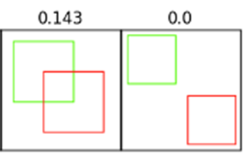
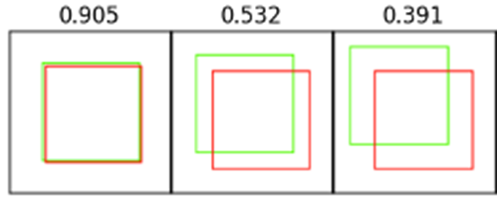
How to Measure Success? - IoU

Slide 5
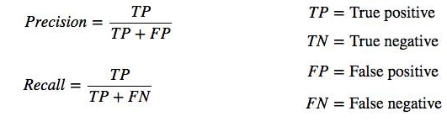
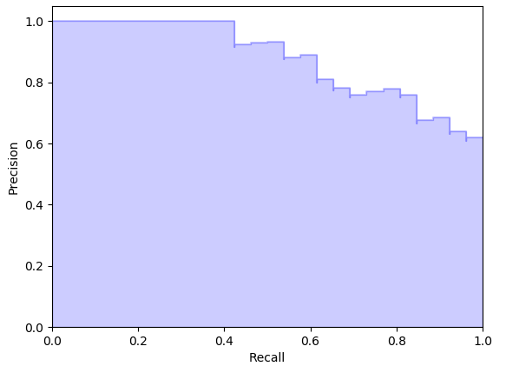
Metrics for Object Detection
Precision measures how accurate is your predictions.
Recall measures how good you find all the positives.

Slide 6
Object Detection. Region Proposals Approach
Classes to detect:
Cat
Display
Keyboard
Bicycle
Table
Book
Bottle
Guitar

Slide 7
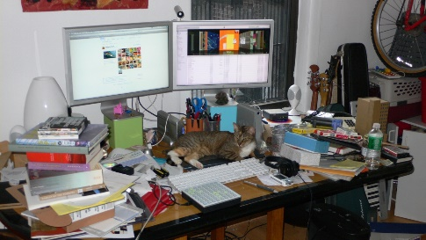
Object Detection. Region Proposals Approach
Proposals
Random
Selective search [1], Edge Boxes [2]
Dense: MultiBox[3], Anchors [4]
Spatial Features
RoI Features
RoI Class &
RoI refinement
[1] J.R.R. Uijlings, K.E.A. van de Sande, T. Gevers, and A.W.M. Smeulders Selective Search for Object Recognition (2012)
[2] C. Lawrence Zitnick and Piotr Doll´ar Edge Boxes: Locating Object Proposals from Edges (2014)
[3] Christian Szegedy, Scott Reed, Dumitru Erhan, Dragomir Anguelov, Sergey Ioffe Scalable High Quality Object Detection (2014)
[4] Shaoqing Ren, Kaiming He, Ross Girshick, and Jian Sun Faster R-CNN: Towards Real-Time Object Detection with Region Proposal Networks (2015)

Slide 8
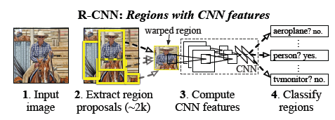
RCNN
[5] Ross Girshick, Jeff Donahue, Trevor Darrell, Jitendra Malik Rich feature hierarchies for accurate object detection and semantic segmentation (2013)

Slide 9
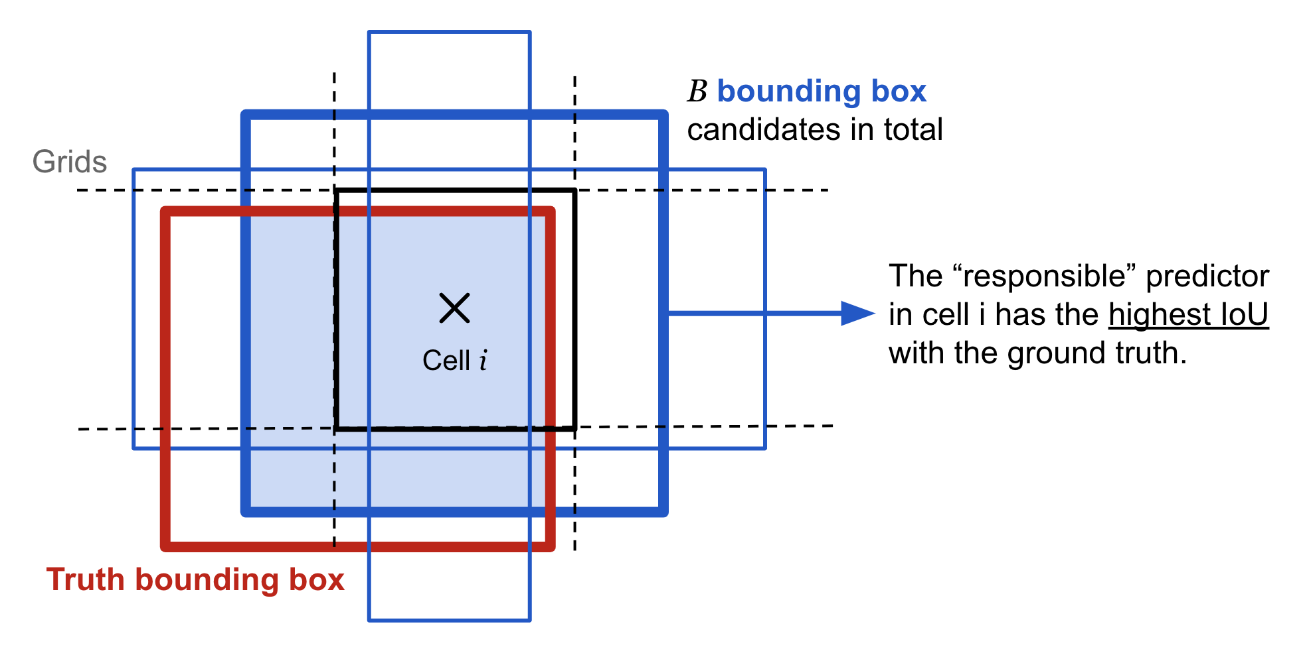
Anchors

Slide 10
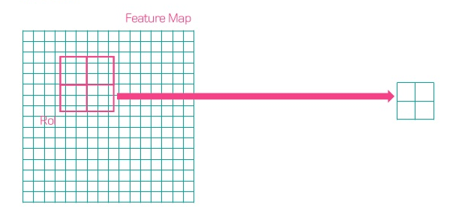
RoI Pooling

Slide 11
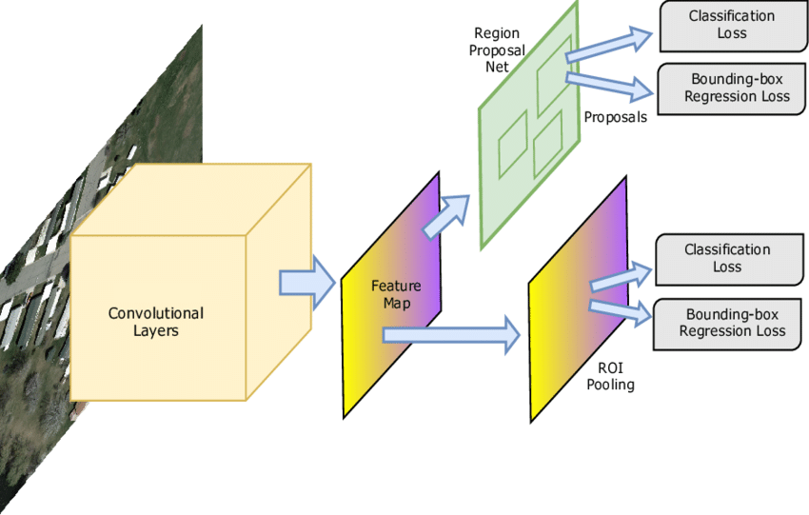
Faster RCNN
[6] Shaoqing Ren, Kaiming He, Ross Girshick, Jian Sun Faster R-CNN: Towards Real-Time Object Detection with Region Proposal Networks (2015)

Slide 12
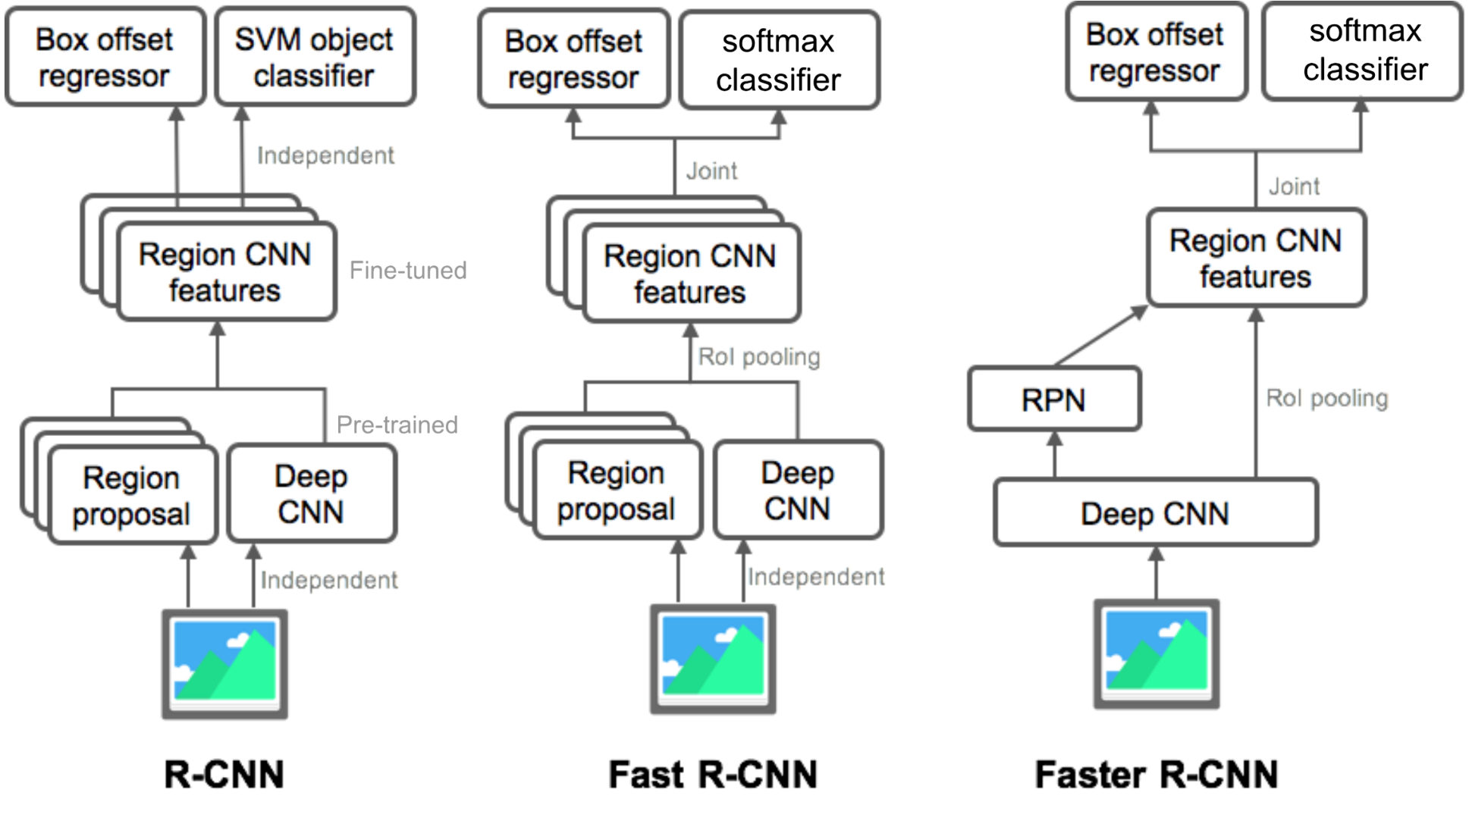
Different networks

Slide 13
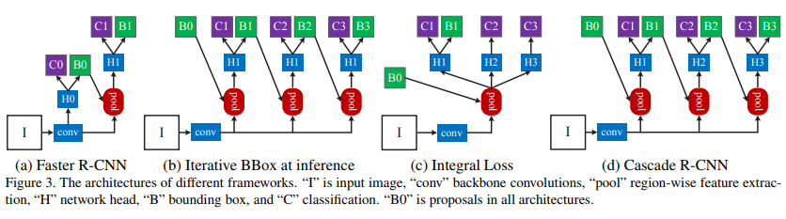
Cascaded-RCNN
[7] Zhaowei Cai, Nuno Vasconcelos Cascade R-CNN: Delving into High Quality Object Detection (2017)

Slide 14
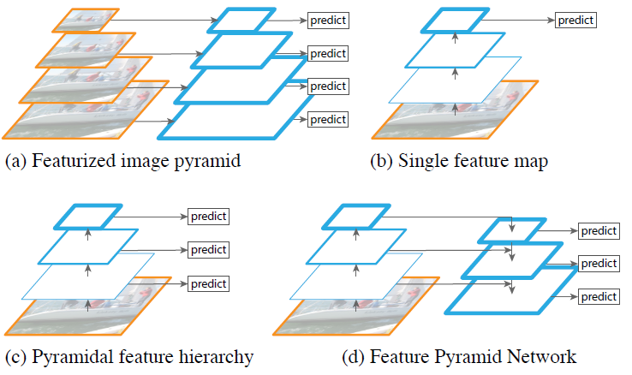
Feature Pyramid Networks
[8] Tsung-Yi Lin, Piotr Dollár, Ross Girshick, Kaiming He, Bharath Hariharan, Serge Belongie Feature Pyramid Networks for Object Detection (2017)

Slide 15
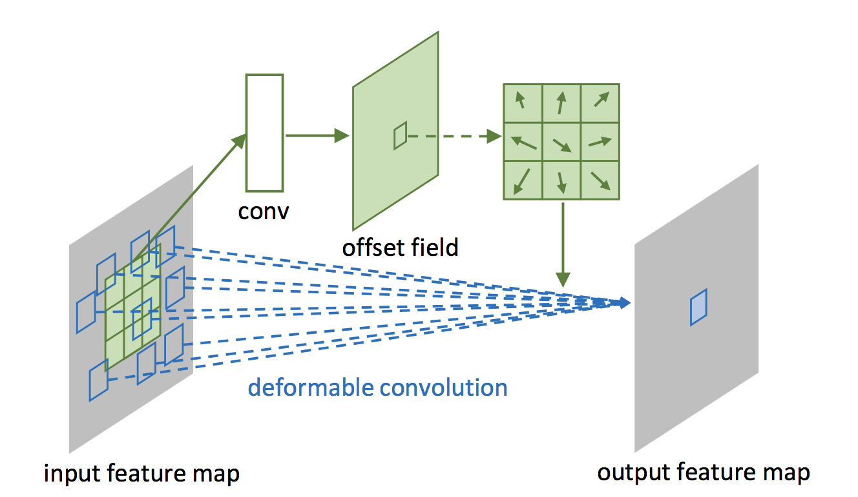
Deformable Convolutions
[9] Jifeng Dai, Haozhi Qi, Yuwen Xiong, Yi Li, Guodong Zhang, Han Hu, Yichen Wei Deformable Convolutional Networks (2017)

Slide 16
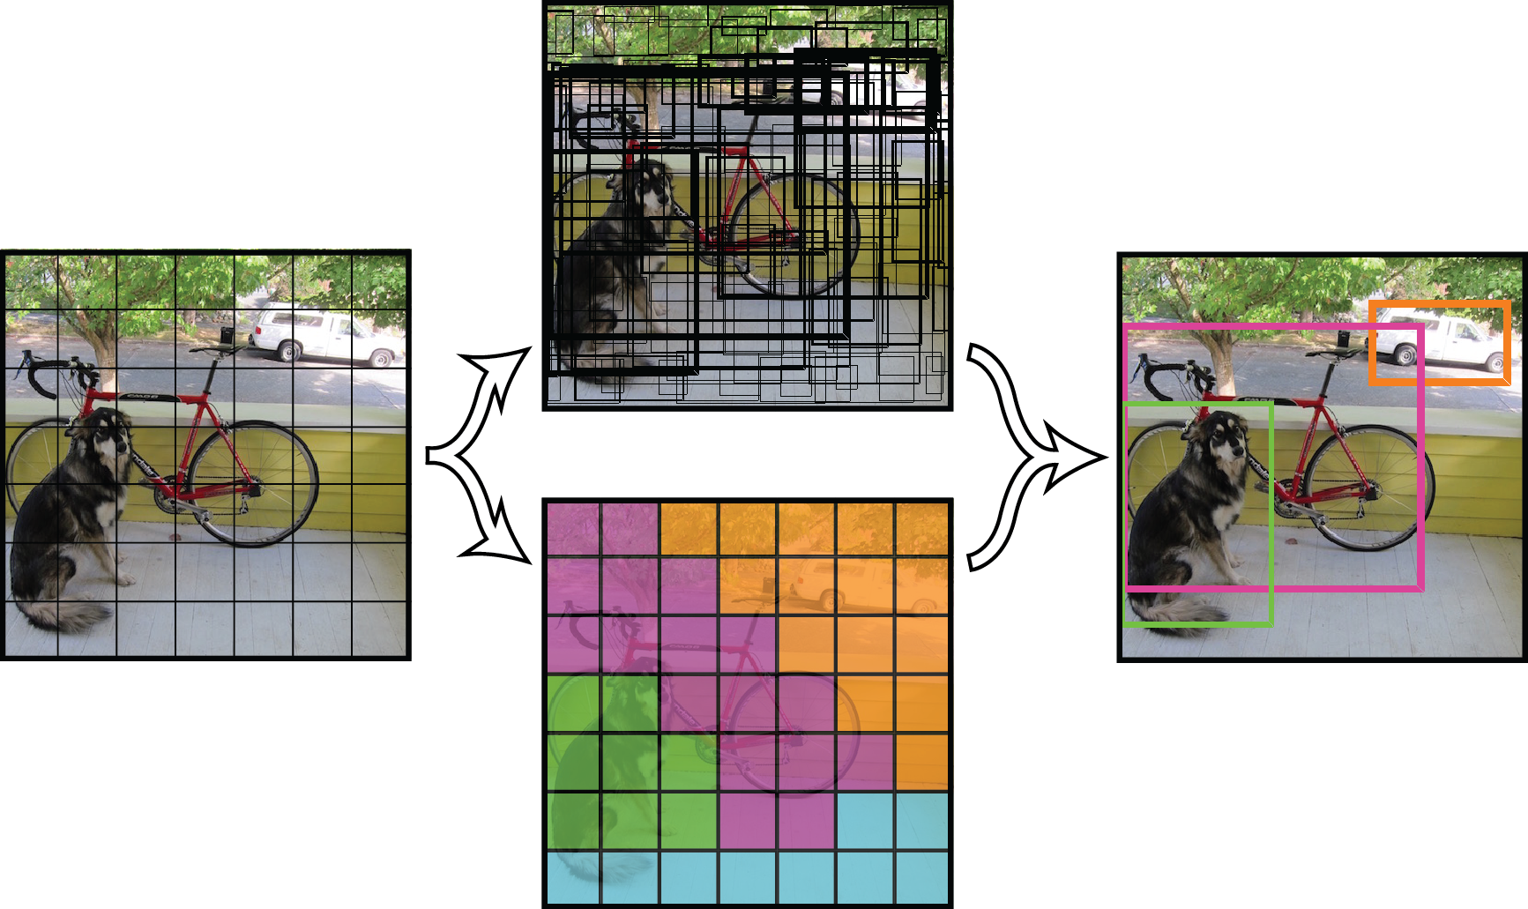
YOLO
YOLO – You Only Look Once
63.4 mAP, 45fps
[10] Joseph Redmon, Santosh Divvala, Ross Girshick, and Ali Farhadi You Only Look Once: Unified, Real-Time Object Detection (2016)

Slide 17
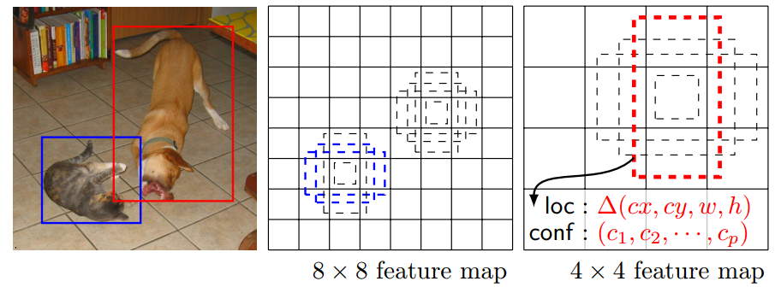
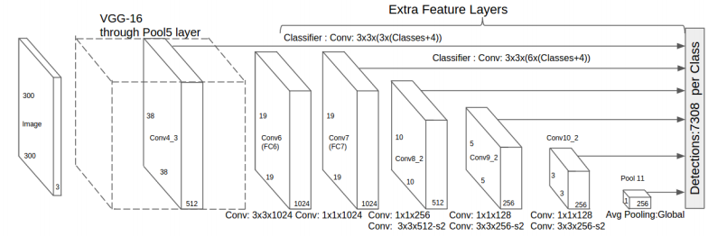
Single Stage Detector
[11] Wei Liu, Dragomir Anguelov, Dumitru Erhan, Christian Szegedy, Scott Reed, Cheng-Yang Fu, Alexander C. Berg SSD: Single Shot MultiBox Detector (2015)

Slide 18
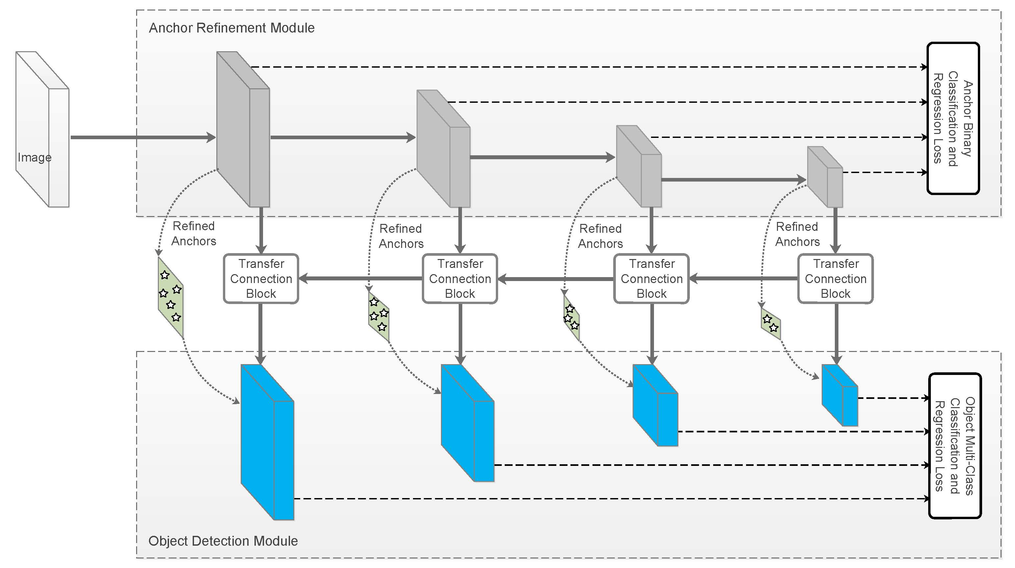
RefineDet
[12] Shifeng Zhang, Longyin Wen, Xiao Bian, Zhen Lei, Stan Z. Li Single-Shot Refinement Neural Network for Object Detection

Slide 19
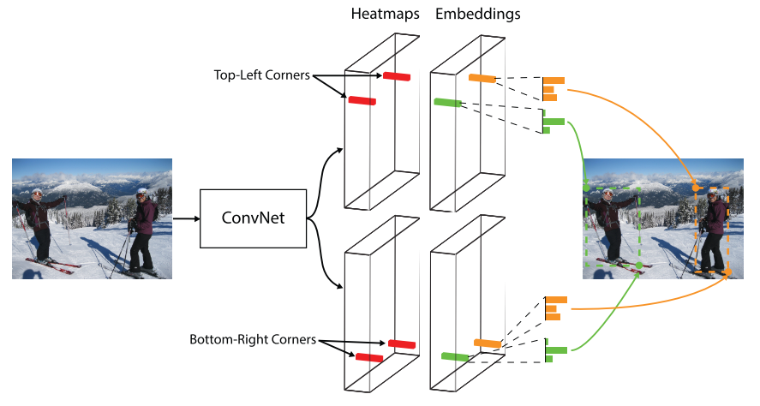
Anchor-less detectors
[13] Hei Law, Jia Deng CornerNet: Detecting Objects as Paired Keypoints

Slide 20
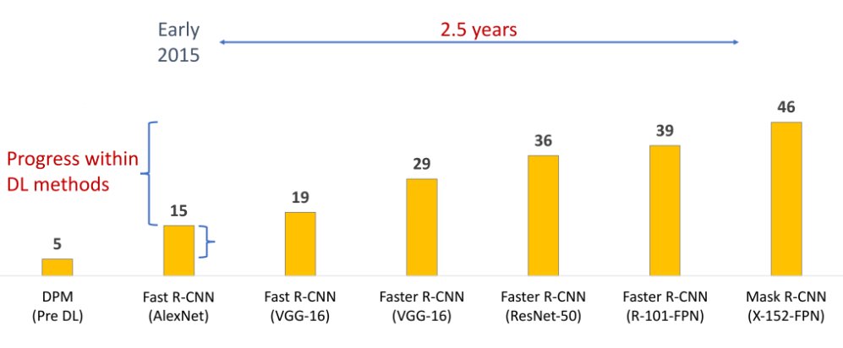
Results on COCO
+ CascadedRCNN
+ Deform Conv
+ Hybrid Task Cascade
-> 50.7
https://github.com/open-mmlab/mmdetection
https://github.com/facebookresearch/Detectron

Slide 21
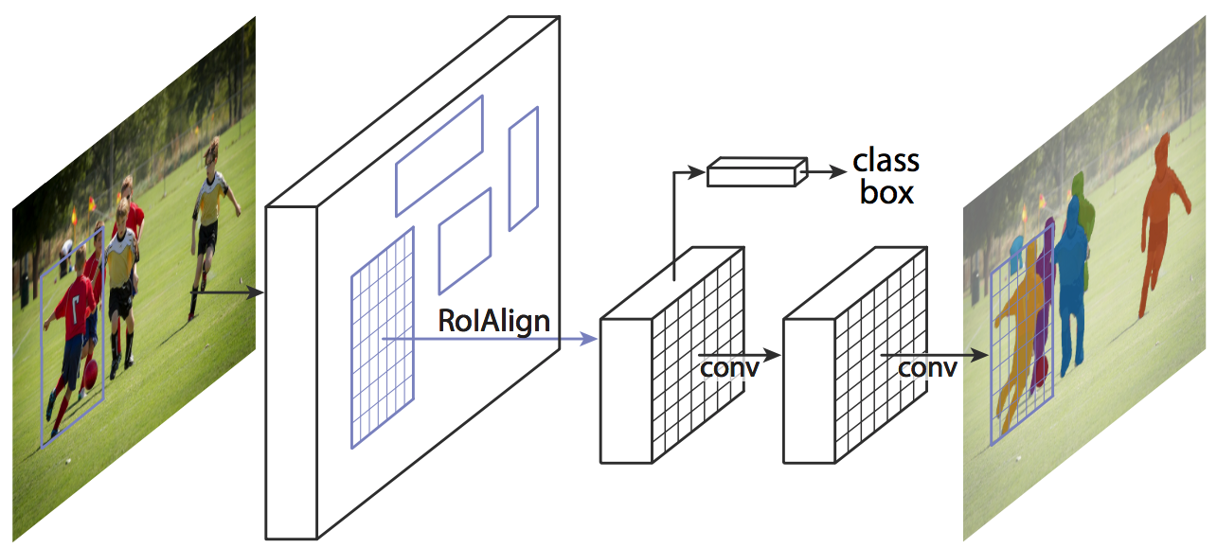
Instance Segmentation. Mask RCNN
[14] Kaiming He, Georgia Gkioxari, Piotr Dollár, Ross Girshick Mask R-CNN (2017)

Slide 22
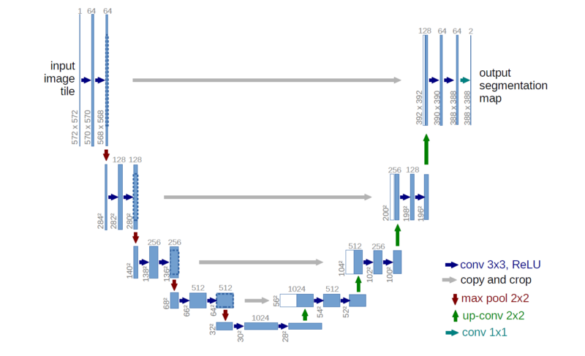
Semantic Segmentation. U-Net
[15] Olaf Ronneberger, Philipp Fischer, Thomas Brox U-Net: Convolutional Networks for Biomedical Image Segmentation (2015)

Slide 23
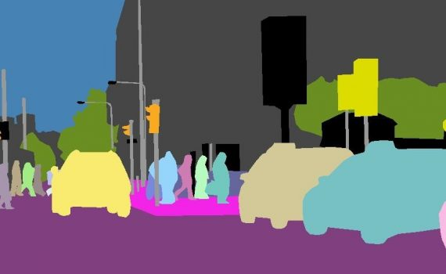
Panoptic Segmentation
[16] Alexander Kirillov, Kaiming He, Ross Girshick, Carsten Rother, Piotr Dollár Panoptic Segmentation (2018)

Slide 24
Feel Free to Contact Me
Oleksandr Baiev, PhD
Head of Machine Perception Lab
Samsung R&D Institute Ukraine
o.baiev@samsung.com
http://facebook.com/baiev

